Slide 1

Analysis of Customer Satisfaction using Sentiment Analysis
Roghieh Farajialamooti
Seda Sensoy
Sraboni Bhuiyan
Group X

Slide 2

Topics
Data Gathering
Preprocessing
Analysis using Naïve Bayes
SVM Machine Learning Model
LSTM Deep Learning Model using Word Embedding Vectorization
LSTM Deep Learning Model using TF-IDF Vectorization
Results

Slide 3
Data Gathering
youtube = build('youtube', 'v3', developerKey='KEY')
video_id = '78IJdhvY1zg'
comments = []
request = youtube.commentThreads().list(
part='snippet',
videoId=video_id,
textFormat='plainText')
while request:
response = request.execute()
for item in response['items']:
comment = item['snippet']['topLevelComment']['snippet']['textDisplay']
comments.append(comment)
request = youtube.commentThreads().list_next(request, response)
Dataset
How to Download
Specification
Excel File of Size 1500 with Two Columns: Comment, Sentiment
Separate 1290 of Data

Slide 4
Preprocessing
Tokenization
Regular Expression: I'm --> "I", ",", "m"
NLTK: I'm ---> "I", "'m"
Digits stick to Words -> Manually Separated
POS Tagging
Challenge: Role of Word
Solution: Add Subject to the sentences starting with verb
Not Relevant
NER
Lemmatization
Notes:
Talk about the challenges & what we did as a solution. Say why we did not consider the last two.

Slide 5

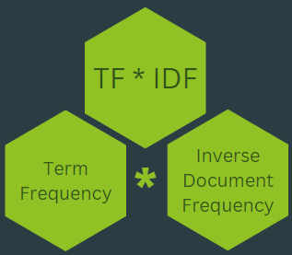
TF-IDF
ngram_range = (1, 3)
num = data['comment'].str.split().explode().nunique()
print('Unique Words in Data: ', num)
tfidf_vectorizer = TfidfVectorizer(ngram_range=ngram_range, min_df=5, max_features=num, stop_words='english')
Notes:
Ngram_range: N-grams play a crucial role in vectorization, as they help capture patterns and relationships between words in a text. In this case, an n-gram of 3 is employed, encompassing unigrams (individual words), bigrams (two-word sequences), and trigrams (three-word sequences). This choice allows for the identification of patterns within sequences of these varying word lengths. Bigrams and trigrams, specifically, prove useful in capturing negations, where phrases like "not happy" are semantically distinct from "happy."
Min_df: The parameter min_df is set to specify the minimum number of documents a term must appear in to be included in the vectorization process. In this instance, a term must appear in at least 5 documents to be considered.
Max_features: The parameter max_features limits the maximum number of unique terms considered during vectorization, and it is set to the number of unique words in the entire dataset which is 3080 words.
Stop_words: Stop words, such as "the" and "a," are deemed unimportant in sentiment analysis. Therefore, the stop_words parameter is configured to include the default set of English stop words.

Slide 6
Sentiment Analysis using TF-IDF Vectorization + Tokens + POS Tags
X_train_new, X_test_new, y_train_new, y_test_new = train_test_split(
data_tfidf, data['sentiment_numeric'], test_size=0.2, random_state=20, stratify=data['sentiment_numeric'])
classifier = MultinomialNB()
classifier.fit(X_train_new, y_train_new)
y_pred = classifier.predict(X_test_new)
accuracy = accuracy_score(y_test_new, y_pred)
classification_rep = classification_report(y_test_new, y_pred, target_names=sentiment_mapping.keys())
print(f'Accuracy: {accuracy:.2f}')
print(classification_rep)

Slide 7
Sentiment Analysis using TF-IDF Vectorization + Tokens + POS Tags
Accuracy: 0.81
Precision recall f1-score support
positive 0.89 0.86 0.88 86
Neutral 0.79 0.74 0.77 86
negative 0.76 0.83 0.79 86
accuracy 0.81 258
macro avg 0.81 0.81 0.81 258
weighted avg 0.81 0.81 0.81 258
Notes:
It demonstrates robust performance across sentiment classes, achieving high precision, recall, and F1-score for each sentiment category. The overall accuracy of 81% signifies effective sentiment prediction on the given dataset. The classifier's balanced performance across classes suggests its reliability in accurately distinguishing sentiments.

Slide 8

Sentiment Analysis using TF-IDF Vectorization + Tokens + POS Tags
Predicted Positive Predicted Neutral Predicted Negative
Actual Positive 74 10 2
Actual Neutral 18 63 5
Actual Negative 10 7 69
Notes:
It demonstrates robust performance across sentiment classes, achieving high precision, recall, and F1-score for each sentiment category. The overall accuracy of 81% signifies effective sentiment prediction on the given dataset. The classifier's balanced performance across classes suggests its reliability in accurately distinguishing sentiments.

Slide 9
SVM
X_train_tfidf = tfidf_vectorizer.fit_transform(X_train)
X_test_tfidf = tfidf_vectorizer.transform(X_test)
param_grid_svm = {'C': [0.1, 1, 10,100], 'gamma': ['scale', 'auto'], 'kernel': ['linear', 'rbf']}
svm_model = SVC(random_state=1)
svm_model_grid = GridSearchCV(estimator=svm_model, param_grid=param_grid_svm, verbose=10, cv=5, n_jobs=-1)
svm_model_grid.fit(X_train_tfidf, y_train)
results_df = pd.DataFrame(svm_model_grid.cv_results_)
print('Grid Search Results:')
print(results_df[['params', 'mean_test_score', 'rank_test_score']])
best_estimator_svm = svm_model_grid.best_estimator_
y_pred = best_estimator_svm.predict(X_test_tfidf)

Slide 10
SVM
Best Estimator: SVC(C=10, random_state=1)
Accuracy: 0.88
Classification Report:
precision recall f1-score support
positive 0.92 0.93 0.92 86
neutral 0.80 0.87 0.83 86
negative 0.92 0.83 0.87 86
accuracy 0.88 258
macro avg 0.88 0.88 0.88 258
weighted avg 0.88 0.88 0.88 258

Slide 11
SVM
Predicted Positive Predicted Neutral Predicted Negative
Actual Positive 79 7 0
Actual Neutral 11 75 0
Actual Negative 0 14 72
Lowest Misclassification

Slide 12
LSTM with Word Embedding Vectorization
X_train = X_train.astype(str)
X_test = X_test.astype(str)
tokenizer = Tokenizer()
tokenizer.fit_on_texts(X_train)
tokenizer.fit_on_texts(X_test)
X_train_sequences = tokenizer.texts_to_sequences(X_train)
X_test_sequences = tokenizer.texts_to_sequences(X_test)
max_sequence_length = num
X_train_padded = pad_sequences(X_train_sequences, maxlen=max_sequence_length, padding='post')
X_test_padded = pad_sequences(X_test_sequences, maxlen=max_sequence_length, padding='post')

Slide 13
LSTM with Word Embedding Vectorization
embedding_dim = 50
embedding_matrix = {}
with open('glove.6B.50d.txt', encoding='utf-8') as f:
for line in f:
values = line.split()
word = values[0]
coefs = np.asarray(values[1:], dtype='float32')
embedding_matrix[word] = coefs
vocab_size = len(tokenizer.word_index) + 1
embedding_matrix_for_model = np.zeros((vocab_size, embedding_dim))
for word, i in tokenizer.word_index.items():
embedding_vector = embedding_matrix.get(word)
if embedding_vector is not None:
embedding_matrix_for_model[i] = embedding_vector

Slide 14

LSTM with Word Embedding Vectorization
Layer (type) Output Shape Param # =================================================================
embedding_4 (Embedding) (None, 2791, 50) 101800
bidirectional_8 (Bidirectional) (None, 2791, 100) 40400
dropout_4 (Dropout) (None, 2791, 100) 0
bidirectional_9 (Bidirectional) (None, 100) 60400
dense_3 (Dense) (None, 3) 303
=================================================================
Total params: 202903 (792.59 KB)
Trainable params: 101103 (394.93 KB)
Non-trainable params: 101800 (397.66 KB)

Slide 15
LSTM with Word Embedding Vectorization
precision recall f1-score support
positive 0.89 0.86 0.88 86
neutral 0.76 0.88 0.82 86
negative 0.91 0.79 0.84 86
accuracy 0.84 258
macro avg 0.85 0.84 0.85 258
weighted avg 0.85 0.84 0.85 258

Slide 16
Predicted Positive Predicted Neutral Predicted Negative
Actual Positive 74 10 2
Actual Neutral 10 76 0
Actual Negative 12 16 68

Slide 17
LSTM with TF-IDF Vectorization
TF-IDF Vectorization:
Converts text to numerical form, preserving important word frequencies
Balances word significance across documents
Model Structure:
Embedding Layer: Projects words into a dense vector space
Bidirectional LSTM Layers: Captures context from both past and future data points
Dropout Layer: Prevents overfitting by randomly dropping units
Dense Output Layer: Classifies text into sentiment categories
Training Details:
Epochs: 10
Batch Size: 16
Validation Split: 10%
Performance Metrics:
Tested accuracy and loss
Improvement across epochs
Challenges & Insights:
Complexity and training time
Overfitting concerns
Effectiveness in capturing sentiment nuances
Notes:
20k minimum data needed to get the effectiveness

Slide 18
LSTM with TF-IDF Vectorization
X_train_tfidf = tfidf_vectorizer.fit_transform(X_train)
X_test_tfidf = tfidf_vectorizer.transform(X_test)
model_lstm = Sequential()
max_sequence_length = max(X_train_tfidf.shape[1], X_test_tfidf.shape[1])
model_lstm.add(Embedding(input_dim=X_train_tfidf.shape[1], output_dim=50, input_length=max_sequence_length))
model_lstm.add(Bidirectional(LSTM(50, return_sequences=True)))
model_lstm.add(Dropout(0.2))
model_lstm.add(Bidirectional(LSTM(50)))
model_lstm.add(Dense(3, activation='softmax'))
model_lstm.compile(loss='sparse_categorical_crossentropy', optimizer='adam', metrics=['accuracy'])
model_lstm.fit(X_train_tfidf.toarray(), y_train, epochs=10, batch_size=16, validation_split = 0.1)
test_loss, test_acc = model_lstm.evaluate(X_test_tfidf.toarray())
Notes:
When constructing the LSTM model, a bidirectional architecture is employed to capture context from both past and future data points within a sequence. The model comprises an embedding layer, transforming text input into dense vectors of fixed size (configured with an output dimension of 50 in the code), two bidirectional LSTM layers with 50 units each for deep learning of text sequences, and a dense layer with a softmax activation function for classification into three categories. To prevent overfitting, a dropout rate of 0.2 is applied, randomly deactivating a fraction of neurons during training to ensure the network learns more robust features that generalize better to unseen data. The model is trained for 10 epochs with a batch size of 16, and validation data is utilized for performance evaluation. It is compiled using the 'adam' optimizer and 'sparse_categorical_crossentropy' as the loss function. Throughout the epochs, the model shows improvement, indicating effective learning.

Slide 19

LSTM with TF-IDF Vectorization
Layer (type) Output Shape Param #
=================================================================
embedding_3 (Embedding) (None, 401, 50) 20050
bidirectional_6 (Bidirectional) (None, 401, 100) 40400
dropout_3 (Dropout) (None, 401, 100) 0
bidirectional_7 (Bidirectional) (None, 100) 60400
dense_2 (Dense) (None, 3) 303
=================================================================
Total params: 121153 (473.25 KB)
Trainable params: 121153 (473.25 KB)
Non-trainable params: 0 (0.00 Byte)
_________________________________________________________________
Notes:
Model Summary: Starting with an Embedding layer of 20,050 parameters, it captures the essence of our text data. We then process this data through two Bidirectional LSTM layers, with a total of 100,000 parameters, enabling the model to understand context from both directions.
A Dropout layer is included to prevent overfitting by ignoring 20% of neurons during training. The model concludes with a Dense layer of 303 parameters, which classifies the sentiments into three categories using the softmax function.
The entire model has 121,153 trainable parameters, allowing it to learn nuanced patterns in language for sentiment analysis.

Slide 20

LSTM with TF-IDF Vectorization
precision recall f1-score support
positive 0.00 0.00 0.00 86
neutral 0.00 0.00 0.00 86
negative 0.33 1.00 0.50 86
accuracy 0.33 258
macro avg 0.11 0.33 0.17 258
weighted avg 0.11 0.33 0.17 258
Notes:
the model's performance on the test dataset is unsatisfactory, evident from a low accuracy of 33.33%. The elevated test loss of 1.0987 indicates significant deviations in the model's predictions from the actual sentiments. For the 'positive' and 'neutral' classes, precision, recall, and F1-score are all reported as 0.00, underscoring the model's inability to effectively predict these sentiments. On the contrary, for the 'negative' class, the model achieves a recall of 1.00, correctly identifying all instances of negative sentiment. However, precision and F1-score are low at 0.33 and 0.50, respectively. The model encounters challenges in generalizing to sentiments other than 'negative,' resulting in an unbalanced performance across different sentiment categories.

Slide 21
LSTM with TF-IDF Vectorization
Predicted Positive Predicted Neutral Predicted Negative
Actual Positive 0 86 0
Actual Neutral 0 86 0
Actual Negative 0 0 86
Notes:
the model's performance on the test dataset is unsatisfactory, evident from a low accuracy of 33.33%. The elevated test loss of 1.0987 indicates significant deviations in the model's predictions from the actual sentiments. For the 'positive' and 'neutral' classes, precision, recall, and F1-score are all reported as 0.00, underscoring the model's inability to effectively predict these sentiments. On the contrary, for the 'negative' class, the model achieves a recall of 1.00, correctly identifying all instances of negative sentiment. However, precision and F1-score are low at 0.33 and 0.50, respectively. The model encounters challenges in generalizing to sentiments other than 'negative,' resulting in an unbalanced performance across different sentiment categories.

Slide 22
Prediction
def predict_sentiment(comment):
comment_sequence = tokenizer.texts_to_sequences([comment])
comment_padded = pad_sequences(comment_sequence, maxlen=50, padding='post')
lstm_predictions = model_lstm.predict(comment_vectorized)
lstm_pretrained_prediction = model_pretrained.predict(comment_padded)
svm_predicted_class_index = np.argmax(svm_prediction)
nb_predicted_class_index = np.argmax(nb_prediction)
lstm_predicted_class_index = np.argmax(lstm_predictions)
lstm_pretrained_prediction_class_index = np.argmax(lstm_pretrained_prediction)
svm_sentiment = sentiment_classes[svm_predicted_class_index]
nb_sentiment = sentiment_classes[nb_predicted_class_index]
lstm_sentiment = sentiment_classes[lstm_predicted_class_index]
lstm_pretrained_sentiment=sentiment_classes[lstm_pretrained_prediction_class_index]
return svm_sentiment, nb_sentiment, lstm_sentiment, lstm_pretrained_sentiment, tokens, pos_tags
Notes:
The index actually converts 0,1,2 labels to negative, neutral, positive

Slide 23
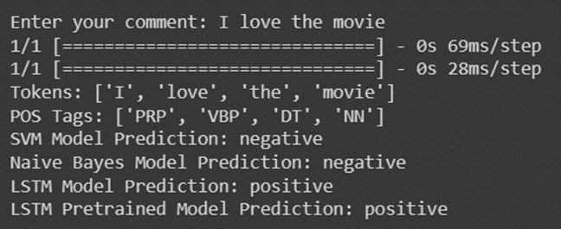
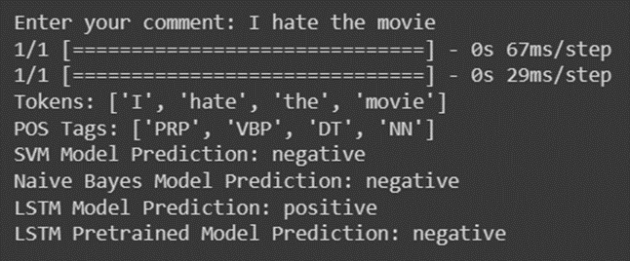
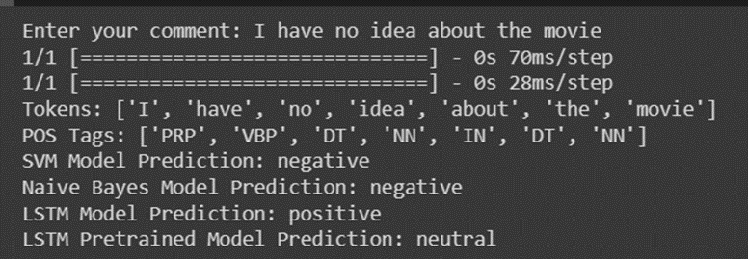
Prediction
def predict_from_command_line():
comment = input('Enter your comment: ')
if comment:
svm_sentiment, nb_sentiment, lstm_sentiment, lstm_pretrained_sentiment, tokens, pos_tags= predict_sentiment(comment)
print(f'Tokens: {tokens}')
print(f'POS Tags: {pos_tags}')
print(f'SVM Model Prediction: {svm_sentiment}')
print(f'Naive Bayes Model Prediction: {nb_sentiment}')
print(f'LSTM Model Prediction: {lstm_sentiment}')
print(f'LSTM Pretrained Model Prediction: {lstm_pretrained_sentiment}')
else:
print('Please enter a comment.')
predict_from_command_line()

Slide 24

Results & Comparison
Compare Results of Different Model:
Model Accuracy
Naïve Bayes 0.81
SVM 0.88
LSTM with Word Embedding Vectorization 0.84
LSTM with TF-IDF Vectorization 0.33
Suggestion:
Best Model: LSTM
Suggestion on Improvement: More Data for Vectorization & Training

